Slide 1

Stormwater Ordinance Updates
June 12, 2025

Slide 2
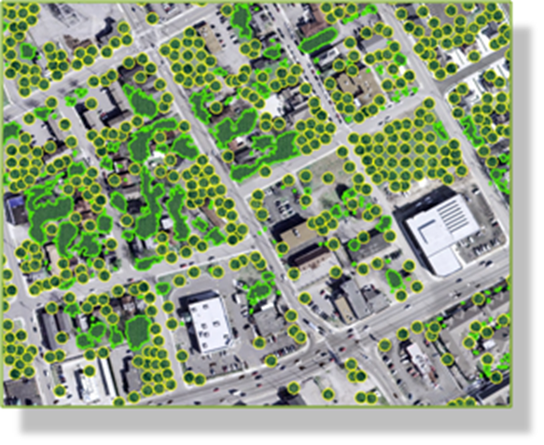
Background
Improve the effectiveness of stormwater control measures.
Adapt to changing environmental conditions and protect water quality.
Comply with state or federal regulations.
Promote sustainable development practices.

Slide 3
Ordinance and Permit Additions
Erosion and Sediment Control
  Grading Permit
Illicit Discharge and Connection
Post-Construction Stormwater Quality
Flood Hazard Protection

Slide 4
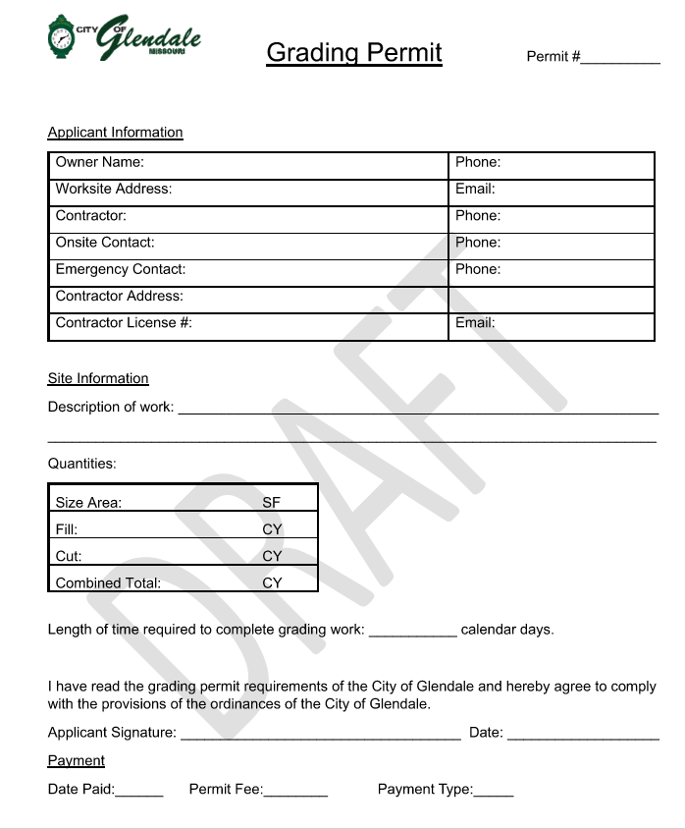
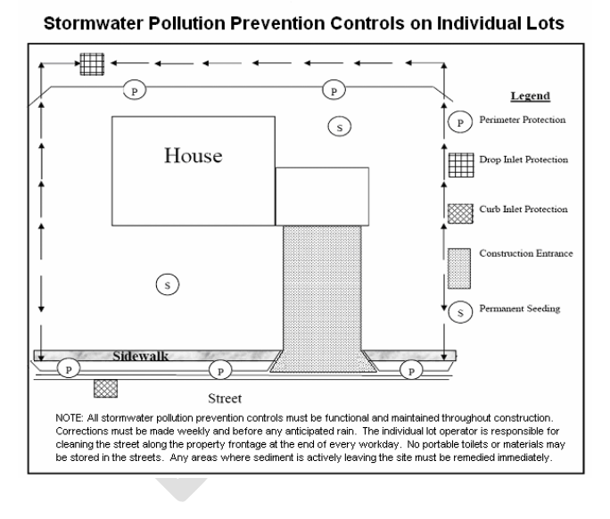
Erosion and Sediment Control
Updates to Requirements
Grading Permit Addition
Requires Erosion & Sediment Control Plan for Every Development
Enforcement Language

Slide 5
Illicit Discharge
Federal regulations defines illicit discharge as: “…any discharge to a MS4 that is not comprised entirely of stormwater..”
Adds code language to disallow non-stormwater discharges into the stormwater system.
Includes provisions for the following:
  Sewage and Wastewater from industrial processes
  Connections from indoor drains
  Non-Dechlorinated Swimming pool discharges
Enforcement Language

Slide 6
Post-Construction Stormwater Quality
Adopts Standards that align with MSD
Governs the selection and design of stormwater quality BMPs
Requires owner to submit plan with pertinent BMP information
Requires proper Construction & Maintenance of Stormwater BMPs required by MSD
Requires SWPPP plans shared with City

Slide 7
Flood Hazard Protection
Updates and addresses FEMA’s National Flood Insurance Program
Ordinance Addresses the following:
  Protects public health, safety, and welfare.
  Minimizes flood-related losses and damages.
  Regulates development in flood-prone areas.
  Informs property owners of flood risks and responsibilities.

Slide 8
Questions?

